Slide 1

CE303
Advanced Programming
Unit 2. Oct 25th, 2022.
Notes:
Is it just fantasy

Slide 2
Today:
Threads and Synchronisation

Slide 3
BUT, FIRST,

Slide 4
BUT, FIRST,
POP QUIZ, HOTSHOT!

Slide 5


Slide 6
class Bomb { private Bus bus; public Bomb ( Bus b ) { this.bus = b; }
public boolean detonateCheck() { return bus.getSpeed() < 50 || bus.detectMovement(); }
}
interface Camera { boolean getCameraFeed( boolean x ); }
class StandardCamera implements Camera{ public boolean getCameraFeed( boolean movement ) { return movement; } }
class Bus {
private int speed; private boolean movement; private Camera camera;
public Bus( int s, Camera c ) { this.speed = s; this.camera = c; }
public int getSpeed() { return this.speed; }
public void evacuateCivilians() { this.movement = true; }
public boolean detectMovement() { return this.camera.getCameraFeed( movement ); }
}
public class Main {
public static void main( String [] args ) {
Bus b = new Bus( 50, new StandardCamera() ); // hack here: 8 characters MAX!
Bomb m = new Bomb( b );
// b.evacuateCivilians(); // enable this when safe to do so!
if (m.detonateCheck()) System.out.println( "BOOM!!!" );
else System.out.println( "(safe)" );
}
}

Slide 7
class Bomb { private Bus bus; public Bomb ( Bus b ) { this.bus = b; }
public boolean detonateCheck() { return bus.getSpeed() < 50 || bus.detectMovement(); }
}
interface Camera { boolean getCameraFeed( boolean x ); }
class StandardCamera implements Camera{ public boolean getCameraFeed( boolean movement ) { return movement; } }
class Bus {
private int speed; private boolean movement; private Camera camera;
public Bus( int s, Camera c ) { this.speed = s; this.camera = c; }
public int getSpeed() { return this.speed; }
public void evacuateCivilians() { this.movement = true; }
public boolean detectMovement() { return this.camera.getCameraFeed( movement ); }
}
public class Main {
public static void main( String [] args ) {
Bus b = new Bus( 50, x->false );
Bomb m = new Bomb( b );
b.evacuateCivilians();
if (m.detonateCheck()) System.out.println( "BOOM!!!" );
else System.out.println( "(safe)" );
}
}

Slide 8
Today:
Threads and Synchronisation

Slide 9
Part I: Introduction

Slide 10
Concurrent Systems
A system is concurrent if some of its activities can occur “simultaneously”
i.e. “at the same time” in some sense, as opposed to “sequentially”.
In a more practical sense, execution of activities can overlap
Concurrency in computing:
Physical: distributed systems, multi-processor machines, graphics processors, devices (RAM, I/O, soundcard)
Logical: multiple apps/threads running “in parallel” on one device
Concurrency may just be virtual, like when using “time-slicing” to run processes concurrently on a single-core machine.
Notes:
Concurrent, from the latin “concurrere” which means “to run together”

Slide 11
Processes vs Threads
A process is an Operating System (OS) entity, corresponding to an instance of a running program
At its simplest, a process is an executing program, with its own process id
Each process has its own address space
Each process’s address space is isolated
Modern OSes are typically capable of running several processes at the same time.
Given memory does not overlap, there exist special mechanisms instead to allow processes to communicate, e.g. sockets, signals, remote method invocation …

Slide 12
Processes vs Threads
A Thread is an OS entity corresponding to a stream of instructions
One or more threads may run (simultaneously) in the context of a process
Each thread belongs to exactly one process, and uses its address space
Each process has at least one thread (e.g. where the main function is executed)
A thread may execute / access any parts of the process code / memory, including parts / memory currently being executed / accessed by another thread.

Slide 13
Memory Area
Class Data
Static variables
Method references
etc
Stack Area
[etc…]
Thread 1 Runtime Stack
[Stack Frames / Local Variables]
…
Thread 2 Runtime Stack
[Stack Frames / Local Variables]
Heap Area
Objects
…
…
PC Registers
[PC for Thread 1]
[PC for Thread 2]
[…]
A Java Process
Some other process (java?)

Slide 14
Processes vs Threads
Processes and threads are not the only kind of concurrency
Special mention: coroutines.
Compared to threads, where the operating system / execution environment switches between multiple threads in a “pre-emptive” manner (according to a scheduling algorithm), coroutines leave the switching algorithm to the programmer
Form of cooperative multitasking by pausing and resuming functions at set points; typically (but not necessarily) on a single thread.
E.g. using ‘yield’ statements in python; asyncio.sleep, etc..
More relevant in other languages (particularly where threads are limited)
e.g. asyncio in python; the 'cooperative' part is implemented in terms of an 'event loop‘: a python object that keeps track of what is running, what is waiting etc.
Notes:
Comparing to other languages

Slide 15
OS support for concurrency / parallelism
The OS / JVM cooperate to run all the threads “in parallel” (physically or virtually)
What if there are more threads than CPU cores?
OS uses time-slicing to run several threads concurrently on a single core
In general, process scheduling is managed by the OS via a scheduling strategy. Thread scheduling is managed by the JVM, and therefore thread switching does not need to interact with the OS.
On most systems, time slicing in threads happens effectively unpredictably and non-deterministically, meaning that a thread may be paused or resumed at any time.
Switching processes is expensive (because it involves address space switching).
Switching threads is cheaper
Allocation of computing resources (i.e. CPU time) is controlled by process and thread priorities
Notes:
Distinction between concurrency and parallelism
Concurrency refers to interleaved execution
Parallelism refers to true parallelism, on different cores
In principle, the two tend to be used interchangeably

Slide 16
Operating System Processes
Modern OSes like Unix or Windows support multiple processes (multitasking).
Java MyProg creates a new process. You can open two terminals and run these at the same time.
Compare to old DOS systems (ever played a game on DOSBOX?))
Each process has an independent address space
Processes do not share variables!
Managed by the operating system
OS ensures processes do not “interfere” (“isolated”)
Need special mechanisms for communication, like signals, sockets, remote method invocation
Switching processes is relatively slow
Requires a lot of copying and loading

Slide 17
(Java) Threads
“Lightweight” concurrent processing
Each thread is an independent flow of control, with its own local variables
A process can have many threads
Threads can share some part of the address space
In Java, this means that there may be shared objects that can be accessed from different threads
Java threads are managed by the JVM
The JVM Thread Scheduler activates / deactivates threads
Each Java program starts with one thread: main()
Switching threads is relatively fast

Slide 18
Part II: Java threads

Slide 19
Defining and Running a new Thread in Java
Define class that implements Runnable
Runnable is a functional interface, which only has one method: void run()
This method defines what the thread should do when launched. You can think of it as being equivalent to the main() method of the “main” thread. The thread terminates when run() exits
Construct an object / instance of this class
Construct a Thread instance from this object
“Start” the thread.
Alternatively:
construct a Thread directly via an anonymous class or lambda expression.
extend Thread (which also implements Runnable), and override its run() method
Pros: Can save a few lines of code; Cons; cannot inherit from other classes due to single inheritance.

Slide 20
public class Greeter implements Runnable
{ private String greeting;
private static final int REPETITIONS = 8;
private static final int DELAY = 100;
public Greeter(String aGreeting) { greeting = aGreeting; }
public void run()
{ try { for (int i = 1; i <= REPETITIONS; i++) { System.out.println(i + ": " + greeting); Thread.sleep(DELAY); } }
catch (InterruptedException exception) { }
}
public static void main(String[] args)
{ Runnable r1 = new Greeter( “Hello, World!” );
Runnable r2 = new Greeter( “Goodbye, World!” );
Thread t1 = new Thread(r1);
Thread t2 = new Thread(r2);
t1.start();
t2.start();
}
}
Notes:
Thread.start() returns immediately after launching the thread – it does not wait for it to finish.
Question: What would happen if main called r1.run() and r2.run() instead of starting new threads?

Slide 21
Greeter Threads: Two typical runs
Run 1
1: Hello!
1: Goodbye!
2: Hello!
2: Goodbye!
3: Hello!
3: Goodbye!
4: Hello!
4: Goodbye!
5: Hello!
5: Goodbye!
6: Hello!
6: Goodbye!
7: Hello!
7: Goodbye!
8: Goodbye!
8: Hello!
Run 2
1: Hello!
1: Goodbye!
2: Hello!
2: Goodbye!
3: Goodbye!
3: Hello!
4: Hello!
4: Goodbye!
5: Goodbye!
5: Hello!
6: Hello!
6: Goodbye!
7: Goodbye!
7: Hello!
8: Hello!
8: Goodbye!

Slide 22
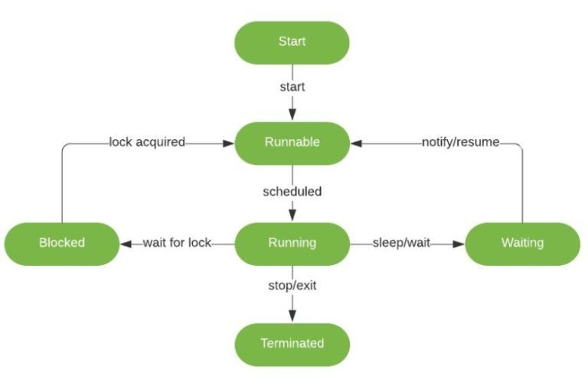
Thread state / lifecycle diagram
Notes:
Note that “Runnable” here means “eligible to be picked up by the scheduler”, and “Running” means actually executing on the CPU.
However, the JVM doesn’t actually distinguish between these two states in code, the inspected state will be RUNNABLE.

Slide 23
Thread states
At any point, each thread is in one of a limited number of states
Once create, a thread needs to be started
The thread suns until its ‘main’ (e.g. run()) method exits, or it is terminated in some other manner (e.g. stopped / interrupted).
Typically when a thread runs, it will switch between runnable and blocked states
Runnable means being in the pool of eligible threads or actually running the code (i.e. utilising CPU)
Blocked means waiting for something
In real life, a typical thread spends most of the time in the blocked state
Waiting for user input
Waiting for Input/Output
Waiting to acquire some shared resource
Sleeping
Etc.

Slide 24
Thread Scheduling
The JVM includes thread schedulers – usually only wrappers for the functionality of the operating system
The scheduler will de-activate a thread in several scenarios:
run() exits
the thread calls yield() – voluntarily give up CPU resource
the thread is blocked (waits for something)
OS decides to switch to another thread (time-slicing)
The scheduler only considers runnable threads
Prefers threads with higher priority, also aging schemes
The scheduler is likely to activate a blocked thread immediately after it being unblocked
Typically a better strategy than using timers / checking periodically some variable’s state
A blocked thread consumes very few computational resources

Slide 25
Terminating threads
Thread terminates when run() exits
If you want to tell a thread to terminate, you can inform it by calling Thread.interrupt()
this will set a boolean field (‘interrupted’) in the Thread data structure
Java checks for this field as soon as it is able to (e.g. unblocked), and triggers a controlled terminating cascade
If a thread is scheduled to stop, isInterrupted() will return true.
After the thread is terminated, an InterruptedException is thrown, and the interrupted flag is reset (to false).
You can also used shared variables to communicate that a thread should stop
Method isAlive() returns true if a thread has been started but it has not terminated yet
Threads are not re-startable.

Slide 26
Typical Structure: Runnable with a loop
public class MyRunnable implements Runnable {
public void run() {
try {
while (…) {
doWork();
Thread.sleep(…);
}
}
catch (InterruptedException e) { … }
}
}
Notes:
E.g. a server expecting to hear from clients, sleeping while all is quiet, waking up every now and then to check, etc
While sleeping thread consumes very few resources.

Slide 27
Part III: Synchronisation

Slide 28
Concurrency: Interleaving
Consider threads t1, t2 with run() methods consisting of two statements each:
t1: public void run() { a; b; }
t2: public void run() { c; d; }
Assume execution of individual statements is “atomic” / “mutually exclusive”
Can a be executed before c?
Can a be executed before d?
Execution of t1 and t2 is “interleaved”.
All you know is “a before b”, and “c before d”
In rare occasions, even that could be wrong due to compiler optimisations

Slide 29
public class CounterThread extends Thread {
static int TOTAL = 0;
static int REPETITIONS = 1000;
public CounterThread() { this.start(); }
public static void inc() { TOTAL++; }
@Override
public void run()
{ for (int i = 0; i < REPETITIONS; i++) { inc(); }
}
public static void main(String[] args) throws Exception
{ Thread t1 = new CounterThread();
System.out.println( "Total = " + TOTAL);
}
}
What is the TOTAL value going to be when we run this program?

Slide 30
CounterThread class
It’s not necessarily 1000!!!
The main method is also running on one thread
This is the default main thread in Java created by the JVM
When our thread t1 is inside the loop counting the values between 0 and 1000, the main thread does not wait
Thus it prints the value of TOTAL at that instance

Slide 31
public class CounterThread extends Thread {
static int TOTAL = 0;
static int REPETITIONS = 1000;
public CounterThread() { this.start(); }
public static void inc() { TOTAL++; }
@Override
public void run()
{ for (int i = 0; i < REPETITIONS; i++) { inc(); }
}
public static void main(String[] args) throws Exception
{ Thread t1 = new CounterThread();
t1.join();
System.out.println( "Total = " + TOTAL);
}
}
The TOTAL should now be 1000, as expected.

Slide 32
Thread Method join()
t.join() waits for thread t to terminate before proceeding
t.join(maxTime) waits at most for maxTime (in ms) for the thread to finish, at which point it returns control back to the caller
This is useful when a parent thread creates one or more child threads to do some work
Parent thread waits for answers before proceeding
Also useful if you want to calculate how long it took until a started thread has finished
In our example, it is needed in CounterThread.main() to ensure that it prints the total after the t1 thread has finished

Slide 33
public class CounterThread extends Thread {
…
public static void main(String[] args) throws Exception
{ Thread t1 = new CounterThread();
Thread t2 = new CounterThread();
t1.join();
t2.join()
System.out.println( "Total = " + TOTAL);
}
}
What is the TOTAL value going to be in this case?

Slide 34
Results from Running CounterThread
Run 1:
total = 2000
Run 2:
total = 2000
Run 3:
total = 1743
Run 4:
total = 2000
Run 5:
total = 1209

Slide 35
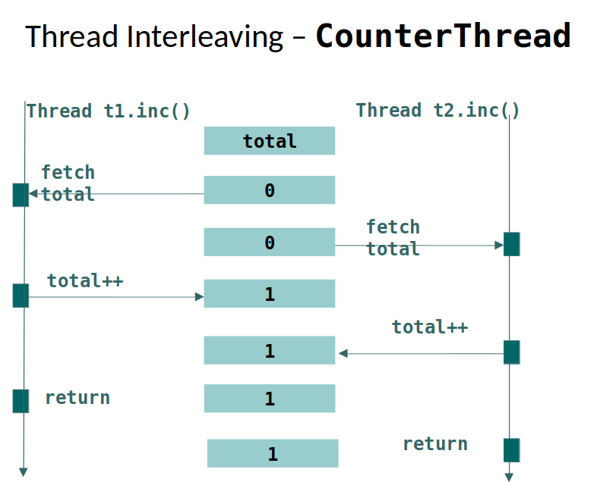

Slide 36
Race Conditions in Threads
When two or more concurrent threads access a common variable
Potential trouble! Problem caused by interleaved reading and writing of shared objects
Reading on its own is ok
Sometimes called race conditions as result depends on who gets access first
Missing atomicity of statements
A thread can yield control half-way through updating a shared object, leaving it in an inconsistent state
Leads to very bad kind of programming errors
Program works “nearly always”. See “Therac-25” incident (1985)!
Java solution: synchronisation and locks

Slide 37
Synchronised Methods and Locks
Java offers synchronized methods
“mutual exclusion” for critical code
public synchronized void myMethod (…) {…}
Each Java object has a built-in “monitor lock”
when a synchronised method is started, it needs to obtain the lock of the object to which it is applied
this stops more than one synchronized method to be applied to this object at the same time.
A static synchronized method locks the class object
Java also has an interface Lock and several implementing classes including ReentrantLock
explicit lock()/unlock() methods
good for coding more sophisticated locking behaviour

Slide 38

Visualizing Locks
Object = phone booth
Thread = person
Locked object = closed booth
Blocked threads = people waiting for booth to open
Monitor/lock = ensures at most one
person is in the booth at any time

Slide 39
Synchronized CounterThread
Change inc() declaration to:
public static synchronized void inc() { … }
Now the value of total is always the same as the overall number of invocations of method inc():
Run 1: total = 2000
Run 2: total = 2000
Run 3: total = 2000

Slide 40
CounterThread: Which Object is Locked?
Method inc() is static. This means that the lock is on the CounterThread.class object
There is only one of these in the JVM
so at most one thread can carry out method inc() at any point in time
Warning: if method inc() was not static, the program above would synchronise on instances of class CounterThread
This would mean, there would be two locks, one for thread t1 and one for thread t2
Thus there would be no contention for the locks, and no protection against concurrent modification of TOTAL
For more information, see:
http://tutorials.jenkov.com/java-concurrency/synchronized.html

Slide 41
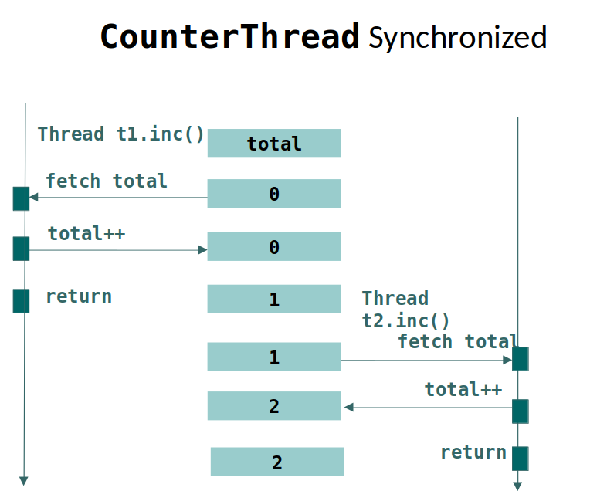

Slide 42
Block Synchronization
Can also synchronise a block of code by associating it explicitly with an object that gets locked / unlocked
Suppose we have two bank account objects
use synchronisation to avoid interference when transferring money from one account to another
synchronized (account1) {
synchronized (account2) {
account1.transfer( -amount );
account2.transfer( amount );
}
}

Slide 43
Remarks about synchronized
CounterThread is correct after adding synchronized
We have made method inc() “atomic”, so two calls of this method can no longer overlap
But: the code is a LOT slower than the incorrect, unsynchronised version, up to a factor ~100 during testing
Only use synchronisation when necessary
When you do need it, be sure to use it!

Slide 44
More efficient synchronisation: AtomicInteger
The object stores a single integer
Provides synchronised functionality with integers
int getAndIncrement() equivalent to value++
int addAndGet(int delta) equivalent to value += delta
int getAndSet(int newValue) sets the value and returns the old value
All operations are thread safe
Much faster than using synchronized methods / blocks
Where possible, exploits platform-specific instructions
Most CPUs (e.g. x86 since 80486) support this on the hardware level

Slide 45
Part IV: Deadlocks

Slide 46
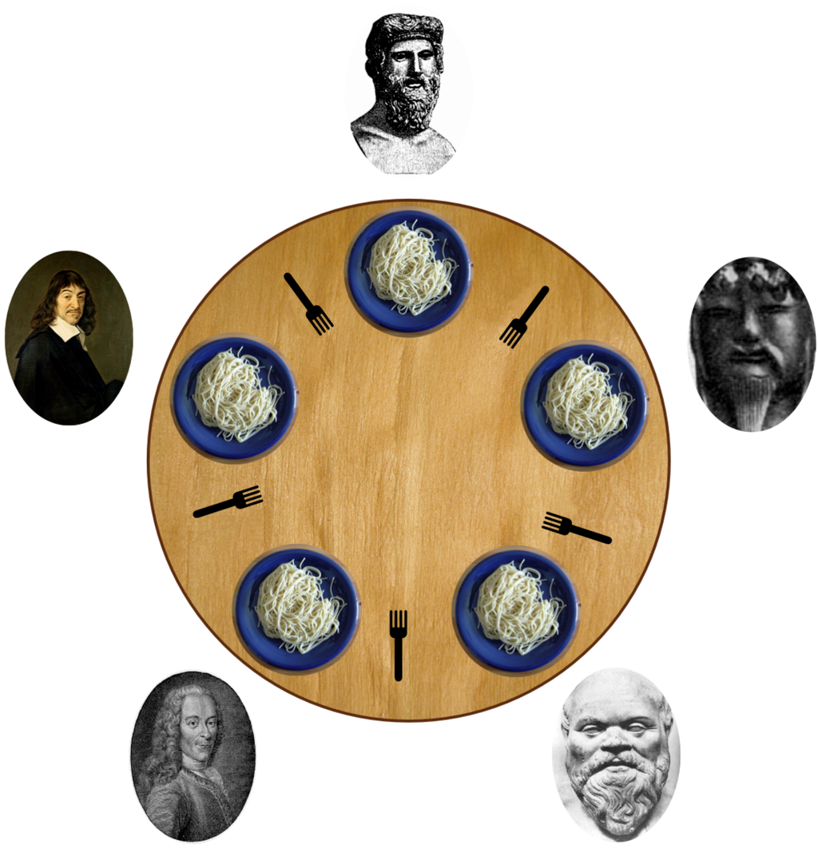
“Dining Philosophers”
*Wikipedia has a good entry on the “Dining Philosophers” problem and its history if you want to know more.

Slide 47
Deadlock (“Starvation”)
Dining philosophers example:
philosophers sit at a round table, eating spaghetti with two forks
assume a philosopher first picks up fork to the right, then picks up fork to the left, then eats, then drops forks
what if everyone picks up fork to their right immediately?
Deadlock situation can arise whenever you have at least two threads and two locks
(for simplicity, think of only 2 philosophers and 2 forks):
Thread (Philosopher) 1 acquires lock on object (fork) A
Thread (Philosopher) 2 acquires lock on object (fork) B
Thread (Philosopher) 1 waits for lock on object (fork) B
Thread (Philosopher) 2 waits for lock on object (fork) A
Deadlock avoidance
programs need to ensure deadlocks are impossible

Slide 48
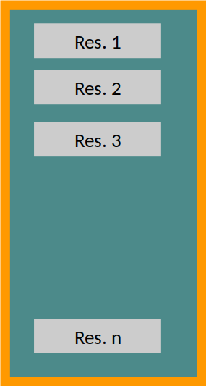
Coarse-grained Concurrency
Uses a single lock for an entire set of resource objects (indicated by the "orange border" in the image)
When one thread has acquired the lock, it stops all others threads from accessing any of the objects in the set
No danger of deadlock
Potentially inefficient as it may cause unnecessary blocking of threads

Slide 49
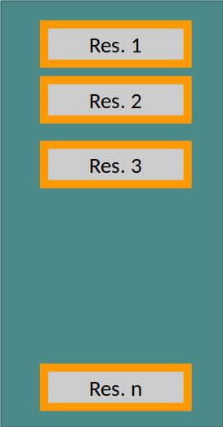
Fine-grained Concurrency
A separate lock for each resource
A thread acquires locks for those objects involved in the current transaction.
Potentially more efficient than a more coarse-grained strategy
less blocking of threads
actual gain depends on various factors such as processor cores, etc.
Danger of deadlock if threads need to acquire (and return) multiple locks for a transaction

Slide 50
Coarse-Grained Dining Philosophers
Implementing a coarse-grained solution for the dining philosophers is straightforward
The synchronisation is done on the entire set of forks
So at most one philosopher can access the forks
This prevents deadlock
But it makes for slow eating
If we interpret the philosophers as processors and eating as “doing work”, then at most one processor is actually working at any point in time

Slide 51
public abstract class Philosopher implements Runnable {
static class Fork { int holder; Fork( int holder) { this.holder = holder; } } // note: Nested Class
final static int COUNT = 5;
final static Fork[] forks = new Fork[COUNT];
static { for (int i = 0; i < COUNT; i++) { forks[i] = new Fork(-1); } } // static block: initialize fork values
int id;
Philosopher(int id) { this.id = id; }
public abstract void run();
public void takeFork(int i) { forks[i].holder = i; System.out.println("Philosopher " +id+ " takes Fork " + forks[i].holder);}
public void dropFork(int i) { forks[i].holder = i; System.out.println("Philosopher " +id+ " drops Fork " + forks[i].holder);}
public void eat() { System.out.println( "Philosopher " + id + " is eating...“ ); }
}
Notes:
Non-static nested classes (inner classes) have access to other members of the enclosing class, even if they are declared private.
Static nested classes do not have access to other members of the enclosing class, unless they're also static.
Static blocks: used for class initialization (takes place before any ‘main’ method runs
Compare to instance blocks: take place at object creation, before constructor code, but after call to super.

Slide 52
public class PhilosopherCoarse extends Philosopher
{
public PhilosopherCoarse(int id) { super(id); }
@Override
public void run() {
int fst = id;
int snd = (id + 1) % COUNT;
synchronized (forks) { takeFork(fst); takeFork(snd); eat(); dropFork(snd); dropFork(fst); }
}
public static void main(String [] args)
{ Thread [] threads = new Thread[ COUNT ];
for (int i = 0; i < COUNT; i++)
{ Runnable philosopher = new PhilosopherCoarse( i );
threads[ i ] = new Thread( philosopher );
threads[ i ].start();
}
}
}

Slide 53
Program Output: PhilosopherCoarse
Philosopher 0 takes fork 0
Philosopher 0 takes fork 1
Philosopher 0 is eating...
Philosopher 0 drops fork 1
Philosopher 0 drops fork 0 ... duration = 5053 ms
Philosopher 9 takes fork 9
Philosopher 9 takes fork 0
Philosopher 9 is eating...
Philosopher 9 drops fork 0
Philosopher 9 drops fork 9
Philosopher 7 takes fork 7

Slide 54
Fine-grained Dinging Philosophers
Lock only the forks needed by each philosopher
the synchronisation ensures that no two philosophers can pick up one fork at the same time
BUT: need to be careful about how we request the locks
Otherwise, could end up in a state of deadlock
Simple deadlock-avoidance strategy: restrict order of requests:
first philosopher takes right fork first, then left fork;
all other philosophers take left fork first, then right fork
Other deadlock-avoidance strategies are possible
Notes:
Visualise on dining table schematic on next slide

Slide 55
“Dining Philosophers”
Notes:
Top: Plato -> Confucius -> Socrates -> Voltaire -> Descartes

Slide 56
public class PhilosopherFine extends Philosopher {
public PhilosopherFine(int id) { super(id); }
@Override
public void run()
{ int fst = (id == 0 ? id : (id + 1) % COUNT); int snd = (id == 0 ? 1 : id);
synchronized (forks[ fst ])
{ takeFork( fst );
synchronized (forks[ snd ]) { takeFork( snd ); eat(); dropFork( snd ); }
dropFork( fst );
}
}
public static void main(String[] args)
{ Thread[] threads = new Thread[ COUNT ];
for (int i = 0; i < COUNT; i++)
{ Runnable philosopher = new PhilosopherFine( I );
threads[ i ] = new Thread( philosopher );
threads[ i ].start();
}
}
}

Slide 57
Program Output: PhilosopherFine
Philosopher 0 takes fork 0
Philosopher 2 takes fork 3
Philosopher 1 takes fork 2
Philosopher 0 takes fork 1
Philosopher 3 takes fork 4 ... duration = 2543 ms
Philosopher 0 is eating...
Philosopher 5 takes fork 6
Philosopher 5 takes fork 5
Philosopher 5 is eating...
Philosopher 6 takes fork 7
Philosopher 7 takes fork 8
Philosopher 8 takes fork 9

Slide 58
PART V:
More advanced synchronisation

Slide 59
Synchronisation primitives
Synchronized/lock sections have very limited functionality
There exist multiple synchronisation primitives (tools) including
ReentrantLock allows at most one thread at a time to access some resource
Semaphore allows at most n threads at a time to access some resource
Barrier synchronises several threads; a thread will wait until all other threads complete some task
E.g. Cyclic Barrier
CyclicBarrier in Java allows a fixed number of threads to wait for each other at some common barrier point
CyclicBarrier.await() blocks until that has happened
Called “cyclic” because the barrier can be re-used after waiting threads have been released
Cyclic barrier can be set up with a barrier action that is executed once per barrier point, after the last thread in the party arrives, but before any threads are released.
Java example: CyclicBarrierDemo

Slide 60
import java.util.concurrent.CyclicBarrier;
public class CyclicBarrierDemo {
final static int COUNT = 3;
final static int REPEATS = 3;
final static CyclicBarrier cb = new CyclicBarrier( COUNT, () -> System.out.println( "All done“ ) );
static class Task implements Runnable
{
int id;
Task(int id) { this.id = id; }
public void run()
{ for (int i = 0; i < REPEATS; i++)
{ System.out.println( "Thread " + id + " done“ );
try { cb.await(); } catch (Exception e) {}
}
}
}
public static void main( String [] args )
{ for (int i = 0; i < COUNT; i++) { new Thread( new Task( i ) ).start(); }
}

Slide 61
CyclicBarrierDemo Output
Thread 0 done
Thread 2 done
Thread 1 done
All done
Thread 1 done
Thread 2 done
Thread 0 done
All done
Thread 2 done
Thread 0 done
Thread 1 done
All done

Slide 62
Multi-Threaded Servers (“Concurrency”)
Many applications have to deal with “real world” concurrency
Like multiple users who may issue task requests concurrently and non-deterministically
Threads can help to code such server applications
Run a separate thread for each concurrent interaction
Servers are often built on top of a standardised multi-threaded environment such as a servlet container like Tomcat
Server threads may be blocked a lot of the time, because they are waiting for the next request
During waiting times, they do not actually use up CPU time

Slide 63
Parallel Programming (“Parallelism”)
Parallel programming tries to divide a computation-intensive task into sub-tasks and execute these at the same time
Can be coded for multi-core or distributed machines
Parallelisation requires a careful breakdown into sub-tasks and allocation over different cores / processors / machines
Try to reduce idle (waiting) times
Not every algorithm can be efficiently parallelised
Communication and memory access are often the bottlenecks
Simply increasing the number of CPUs does not necessarily improve the performance
In fact, overheads may even worsen the performance

Slide 64
Summary
Java fully supports multi-threaded programming
Synchronised methods and synchronised blocks can be used to control access to shared objects
Choice of synchronisation (locking) strategy
coarse-grained concurrency is simpler, less danger of deadlock, potentially poorer performance
fine-grained concurrency is more complex, needs more care to avoid deadlocks, potentially better performance
Barriers and semaphores can help to coordinate the progress of different threads
Multi-threaded servers versus parallel programming

Slide 65
Academic hours: Wednesdays 09:00-11:00 (please email if you can)
Notes:
Announcement: We have been split into two locations at uni, the CSEE labs, (roughly 120+ capacity) and CTC IT labs, (roughly 60+).
Can I ask the leftmost two thirds of the lecture theatre to go to CSEE: Lab 1 Mushfika and Constantina, overflow at Lab 4 with Bruno,
and then the rightmost (as I see the lecture theatre) to go to CTC with Guangming and (initially) me.
I will do my best to ‘hover’ long distance ☺

